Slide 1
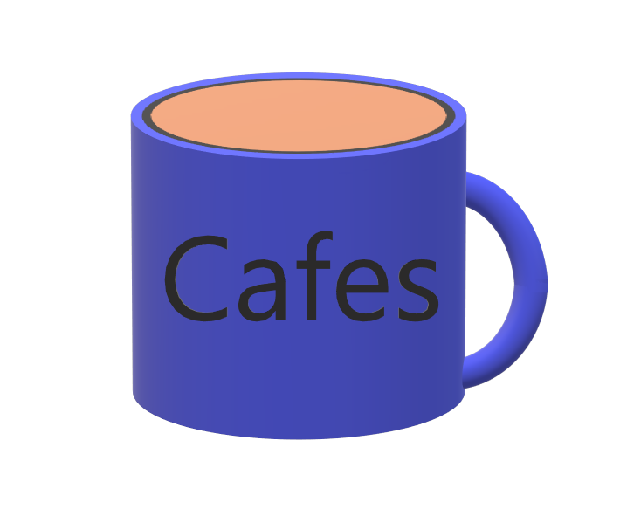
Weekly Status Report 1
Cafes

Slide 2
Stymphalion
2D Open World Adventure
Greek Mythology Theme

Slide 3
Git Structure and Initial Contributions

